Slide 1

7th Grade Math
Unit 5, Lesson 3 Making Population Predictions – Part 1 Volume 1, pg. 191

Slide 2


Benchmark
MA.7.DP.1.3
Given categorical data from a random sample, use proportional relationships to make predictions about a population.
volume 1, pg. 191

Slide 3
Integrated Mathematical Thinking and Reasoning Standards
MA.K12.MTR.4.1 Engage in discussions that reflect on the mathematical thinking of self and others.
MA.K12.MTR.6.1 Assess the reasonableness of solutions.
MA.K12.MTR.7.1 Apply mathematics to real-world contexts.
volume 1, pg. 191

Slide 4

Learning Target
I can use proportional relationships to make predictions about a population.
volume 1, pg. 191

Slide 5

Warm-Up
volume 1, pg. 192

Slide 6
5.3.1 Warm-Up: Notice and Wonder
Burgers | Chips | Fries
Deluxe Burger | $6.90 | $7.70
Deluxe Cheese | $7.70 | $8.45
Bacon Burger | $7.95 | $8.65
Bacon Cheese | $8.25 | $8.95
Double Burger | $8.35 | $9.30
Double Cheese | $9.25 | $9.95
Double Bacon Cheese | $9.50 | $10.25
Cheese Garden Burger | $8.25 | $8.85
Mushroom Swiss | $8.25 | $8.95
Jalapeno Pepper Jack | $8.25 | $8.95
BBQ Western Bacon | $9.20 | $9.85
Pastrami Burger | $9.20 | $9.85
Power Pac | $10.45 | $11.05
Cheese Power Pac | $11.25 | $11.70
What are two things you notice about this menu?
volume 1, pg. 192
Notes:
Video Link: https://algebranation.wistia.com/medias/fi4fidi5y8

Slide 7
What is one thing you wonder?
What is a suggestion you could give to the owners about their pricing?
volume 1, pg. 192
Notes:
Video Link: https://algebranation.wistia.com/medias/fi4fidi5y8

Slide 8

Guided Instruction
volume 1, pg. 192

Slide 9

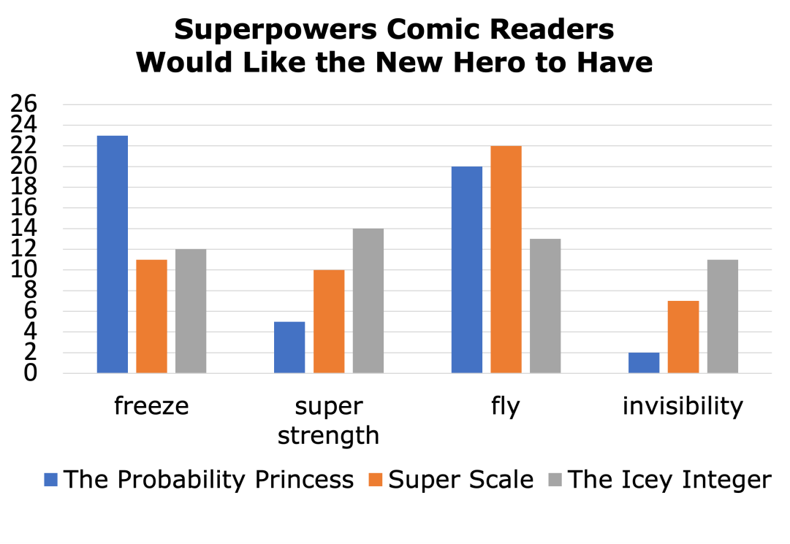
5.3.2 Guided Instruction: Predicting How Many
Results of a random sample can be used to make predictions. The results from a sample of 50 readers of each comic book are shown below.
volume 1, pg. 192

Slide 10
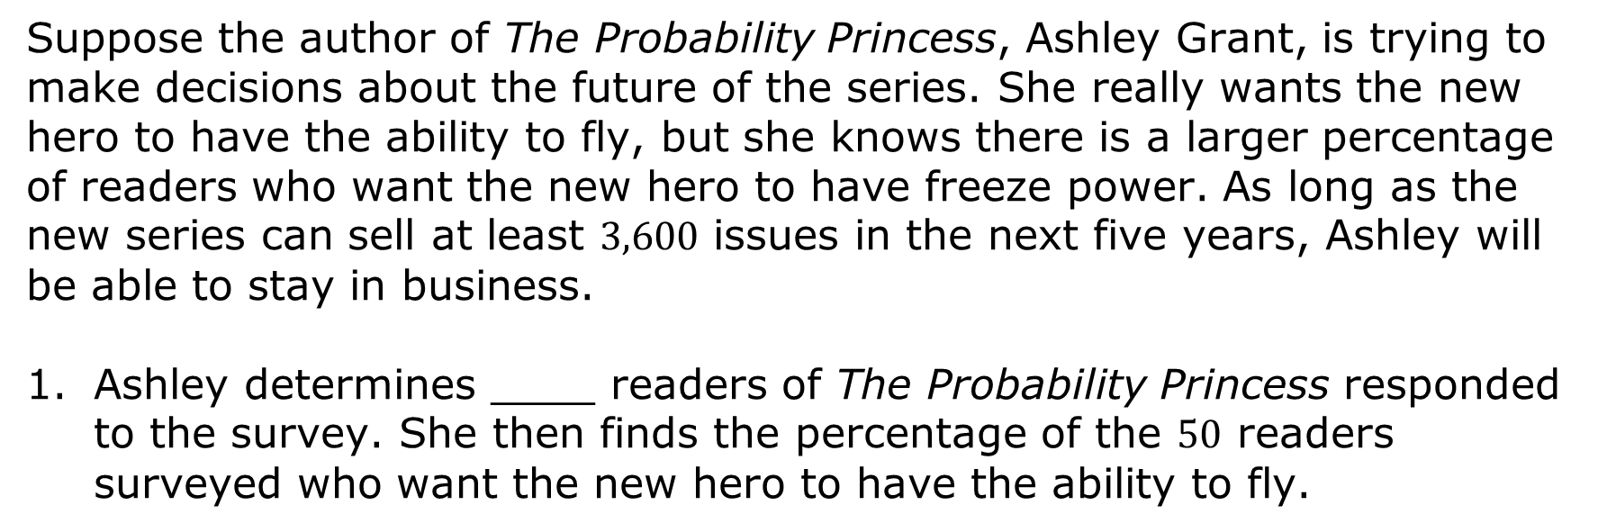

Suppose the author of The Probability Princess, Ashley Grant, is trying to make decisions about the future of the series. She really wants the new hero to have the ability to fly, but she knows there is a larger percentage of readers who want the new hero to have freeze power. As long as the new series can sell at least $3,600$ issues in the next five years, Ashley will be able to stay in business.
Ashley determines ____ readers of The Probability Princess responded to the survey. She then finds the percentage of the $50$ readers surveyed who want the new hero to have the ability to fly.
$$\frac{}{50} = \frac{40}{100} = = 40\%$$
volume 1, pg. 192

Slide 11
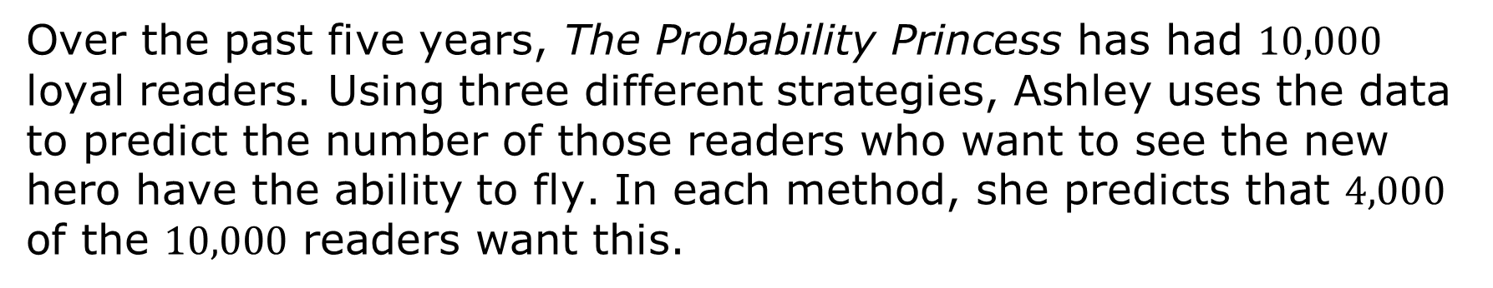
Over the past five years, The Probability Princess has had $10,000$ loyal readers. Using three different strategies, Ashley uses the data to predict the number of those readers who want to see the new hero have the ability to fly. In each method, she predicts that $4,000$ of the $10,000$ readers want this.
volume 1, pg. 193

Slide 12
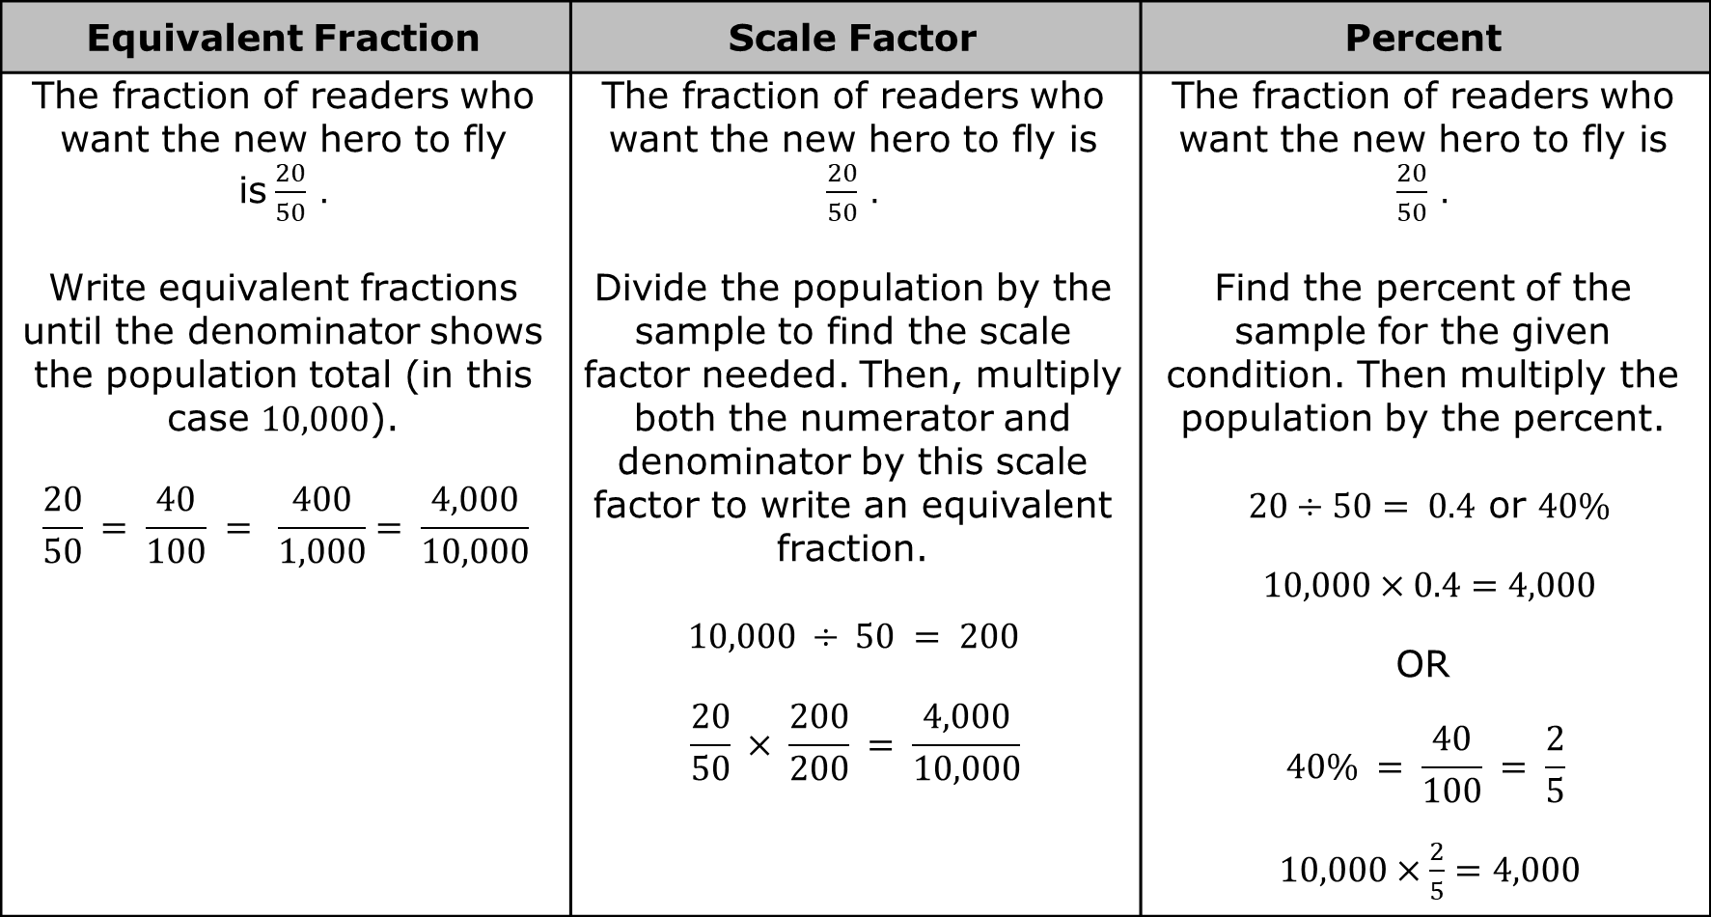
Equivalent Fraction | Scale Factor | Percent
The fraction of readers who want the new hero to fly is$\frac{20}{50} .$ Write equivalent fractions until the denominator shows the population total (in this case 10,000). $$\frac{20}{50} = \frac{40}{100} = \frac{400}{1,000}= \frac{4,000}{10,000}$$ | The fraction of readers who want the new hero to fly is $\frac{20}{50} .$ Divide the population by the sample to find the scale factor needed. Then, multiply both the numerator and denominator by this scale factor to write an equivalent fraction. $10,000 ÷ 50 = 200$ $$\frac{20}{50} × \frac{200}{200} = \frac{4,000}{10,000}$$ | The fraction of readers who want the new hero to fly is $\frac{20}{50} .$ Find the percent of the sample for the given condition. Then multiply the population by the percent. $20÷50= 0.4$ or $40\%$ $10,000×0.4=4,000$ OR $$40\% = \frac{40}{100} = \frac{2}{5}$$ $10,000×\frac{2}{5}=4,000$
volume 1, pg. 193

Slide 13
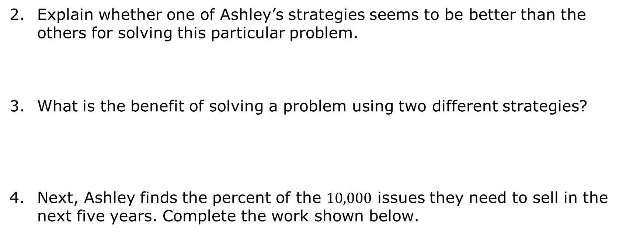
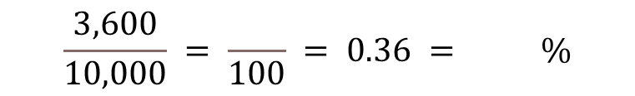
Explain whether one of Ashley’s strategies seems to be better than the others for solving this particular problem.
What is the benefit of solving a problem using two different strategies?
Next, Ashley finds the percent of the $10,000$ issues they need to sell in the next five years. Complete the work shown below.
$$\frac{3,600}{10,000} = \frac{ }{100} = 0.36 = \%$$
volume 1, pg. 193

Slide 14
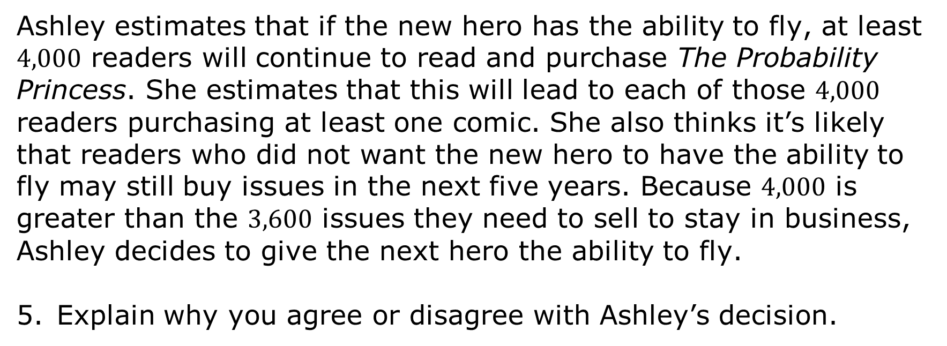
Ashley estimates that if the new hero has the ability to fly, at least $4,000$ readers will continue to read and purchase The Probability Princess. She estimates that this will lead to each of those $4,000$ readers purchasing at least one comic. She also thinks it’s likely that readers who did not want the new hero to have the ability to fly may still buy issues in the next five years. Because $4,000$ is greater than the $3,600$ issues they need to sell to stay in business, Ashley decides to give the next hero the ability to fly.
Explain why you agree or disagree with Ashley’s decision.
volume 1, pg. 193

Slide 15

Exploration
volume 1, pg. 194

Slide 16

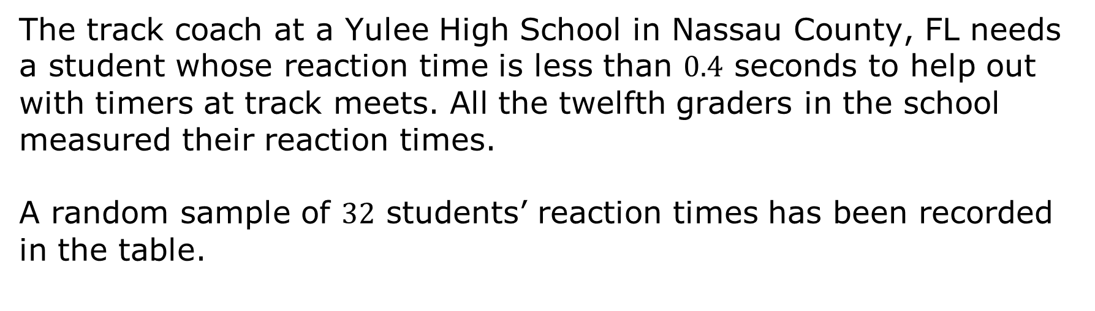
5.3.3 Exploration: Reaction Times
The track coach at a Yulee High School in Nassau County, FL needs a student whose reaction time is less than $0.4$ seconds to help out with timers at track meets. All the twelfth graders in the school measured their reaction times.
A random sample of $32$ students’ reaction times has been recorded in the table.
Reaction Times of Less Than 0.4 Seconds | Reaction Times of 0.4 Seconds or More
22 | 10
volume 1, pg. 194

Slide 17
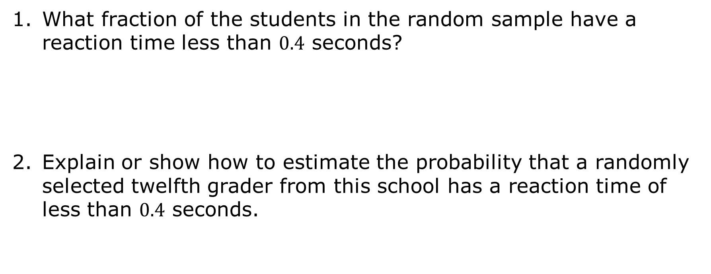
What fraction of the students in the random sample have a reaction time less than $0.4$ seconds?
Explain or show how to estimate the probability that a randomly selected twelfth grader from this school has a reaction time of less than $0.4$ seconds.
volume 1, pg. 194

Slide 18
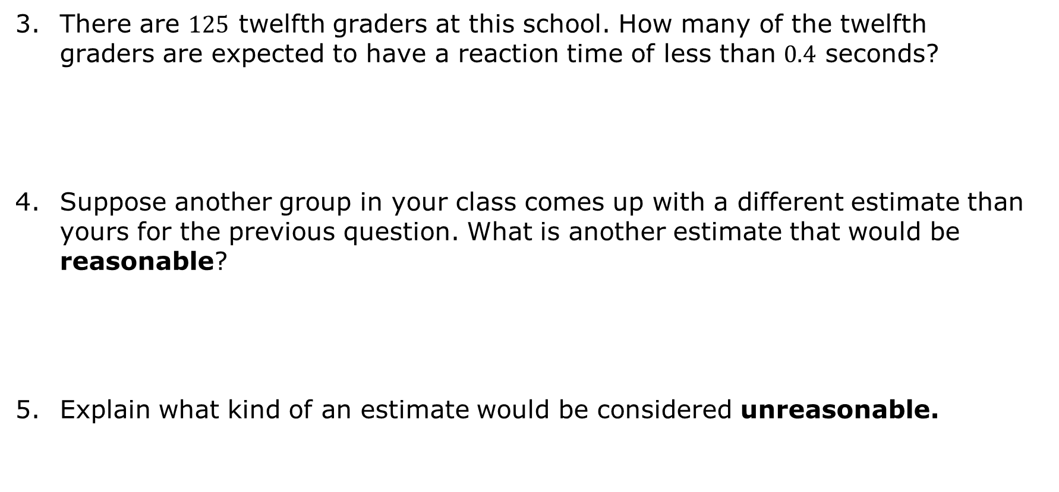
There are $125$ twelfth graders at this school. How many of the twelfth graders are expected to have a reaction time of less than $0.4$ seconds?
Suppose another group in your class comes up with a different estimate than yours for the previous question. What is another estimate that would be reasonable?
Explain what kind of an estimate would be considered unreasonable.
volume 1, pg. 194

Slide 19

Guided Practice
volume 1, pg. 195

Slide 20

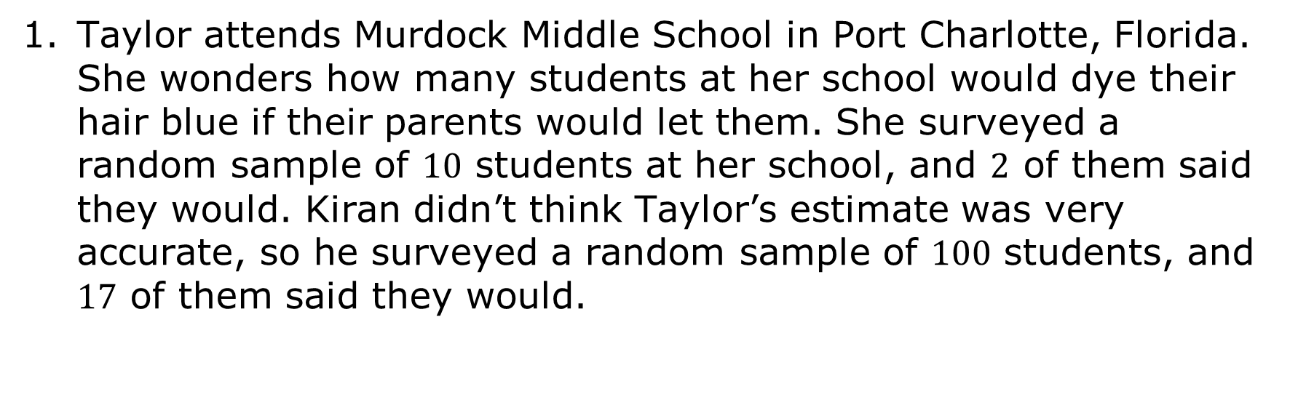
5.3.4 Guided Practice: Making Population Predictions
Taylor attends Murdock Middle School in Port Charlotte, Florida. She wonders how many students at her school would dye their hair blue if their parents would let them. She surveyed a random sample of $10$ students at her school, and $2$ of them said they would. Kiran didn’t think Taylor’s estimate was very accurate, so he surveyed a random sample of $100$ students, and $17$ of them said they would.
volume 1, pg. 195

Slide 21
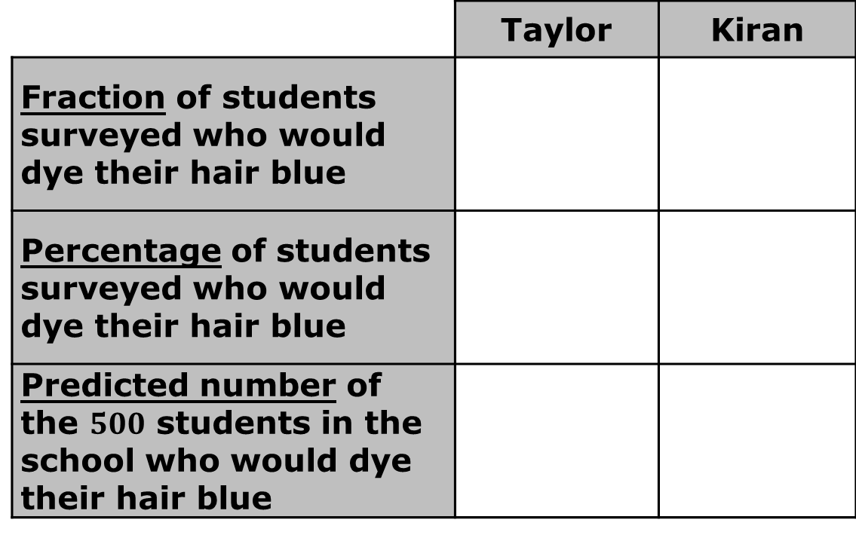
Complete the table below to compare the accuracy of Taylor and Kiran’s random samples. Be sure to show your work or explain your thinking.
 |  | Taylor | Kiran
 | Fraction of students surveyed who would dye their hair blue
 | Percentage of students surveyed who would dye their hair blue
 | Predicted number of the $500$ students in the school who would dye their hair blue
volume 1, pg. 195

Slide 22
Explain whose random sample likely produced the most accurate estimate.
volume 1, pg. 195

Slide 23
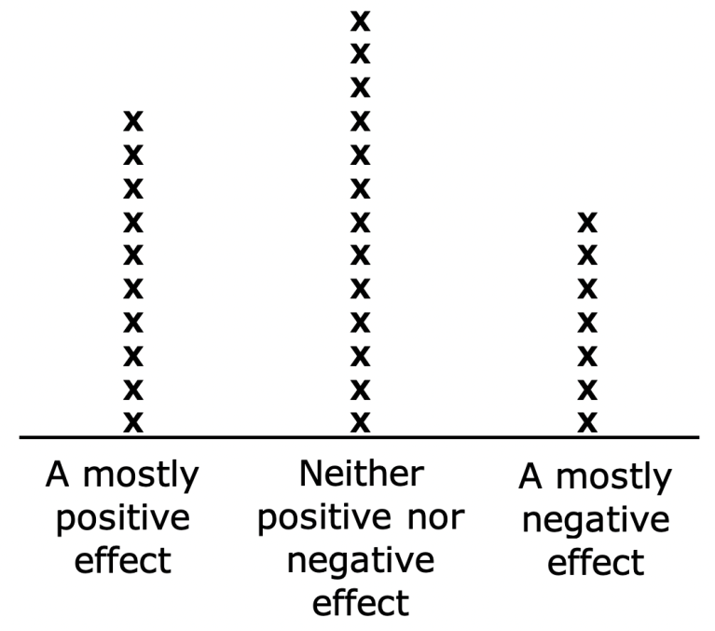
Ms. Jeffrey teaches seventh grade in Miami, Florida. She noticed many of her students talked about social media and wondered about what her students considered to be the impact of all their online activity. She conducted a random survey of 30 seventh-grade students asking them how they describe the effect of social media use on people their own age. The results are shown in the line plot below.
volume 1, pg. 195

Slide 24
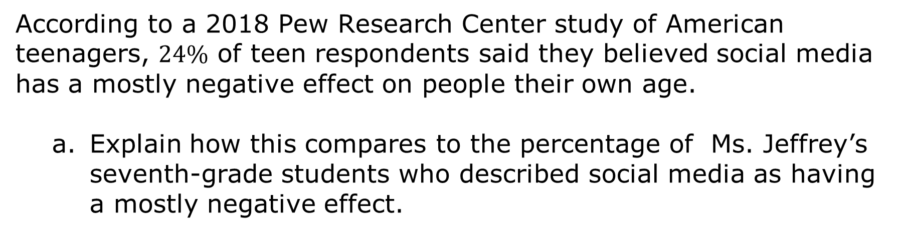
According to a 2018 Pew Research Center study of American teenagers, $24\%$ of teen respondents said they believed social media has a mostly negative effect on people their own age.
Explain how this compares to the percentage of Ms. Jeffrey’s seventh-grade students who described social media as having a mostly negative effect.
volume 1, pg. 195

Slide 25
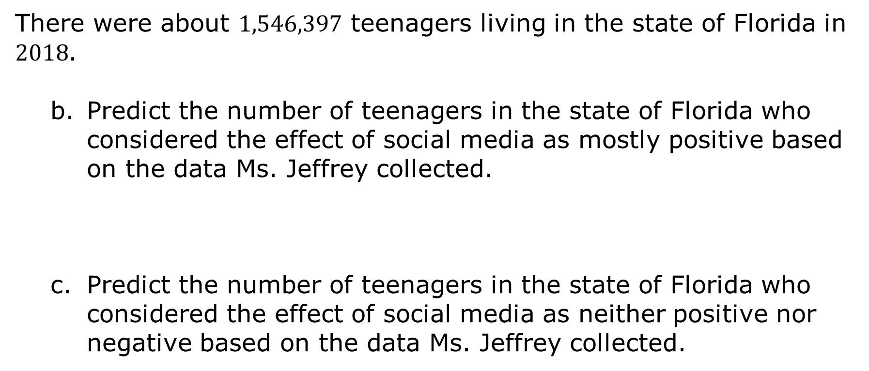
There were about $1,546,397$ teenagers living in the state of Florida in $2018$.
Predict the number of teenagers in the state of Florida who considered the effect of social media as mostly positive based on the data Ms. Jeffrey collected.
Predict the number of teenagers in the state of Florida who considered the effect of social media as neither positive nor negative based on the data Ms. Jeffrey collected.
volume 1, pg. 196

Slide 26
Explain at least two factors that could account for differences in these estimates from the actual number of students who would have described the effect of social media in these ways.
Why are they different?
volume 1, pg. 196

Slide 27
The results of the 2018 Pew Research Study are shown in the circle graph.
mostly positive effect
neither positive nor negative effect
volume 1, pg. 196

Slide 28
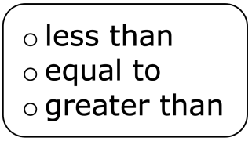
The percentage of teens who describe social media as having a positive effect on people their age is the percent of students who responded the same in Ms. Jeffrey’s survey. Write an explanation of why this may have happened.
volume 1, pg. 196

Slide 29

Wrap-Up
volume 1, pg. 197

Slide 30
5.3.5 Wrap-Up: Growth Mindset
Complete the following sentences based on today’s learning target:
I can use proportional relationships to make predictions about a population.
A barrier to my learning today was …
I will try to overcome this by …
volume 1, pg. 197

